Slide 1
Hotel Booking Analysis
CAPSTONE PROJECT-01
vikas kumar

Slide 2
Content to discuss in this presentation
Introduction to our project
Data Summary
Correlational matrix
Data Extraction
Hotel wise Analysis
Yearwise bookings of hotels.
Hotel booking according to each country.
Some important questions
Conclusion

Slide 3

1.INTRODUCTION TO OUR PROJECT
This project is based on the booking in the hotels of year 2015-2017. In this project, we have discussed about hotel booking analysis. We had provided some dataset from which we have to find the information about the hotel. The problem that we faced about we had the large numbers of data from which we have extract those exact numbers.

Slide 4
2.
DATA SUMMARY (1)
In this dataset, we have different types of columns. In which the data types of those columns are different. Here we have total 32 columns. In this slide, we will discuss about some of them.
Hotel- There are two types of hotel in this dataset. First is City hotel and another is resort hotel.
Country- In this columns, we have given the different names of country from which the guest was originated.
Is_ canceled- In this column, we have given the either the booking done or closed.
Lead_time- The lead time is the time lapse between reservation and actual arrival time.
Is_repeated_guest- This columns shows that the guest is repeated in any hotel or not. If the values is 1 then it means guest repeated here and if it shows 0 then the guest did not repeat the hotel.

Slide 5
DATA SUMMARY (2)
Customer_type- In this column, we have different type of customer. For example, Transient, group, etc
Days_in_waiting_list- Number of days between actual booking and transact.
stayed_in_weekend_nights:-The number of stay per weekend nights.
Reservation_status- There are two types of reservation status. For example, Checked out or canceled.

Slide 6
Hotel Booking Analysis
We have explored the following points while doing this analysis-
The following points/questions are given below:-
1. Finding the correlation between the numerical data.
2. Preferred hotel types.
3. Which month has most peak booking?
4. Optimal length of the stay in the hotel.
5. Which year has most peak booking?
6.Which country has the most numbers booking done by the customer?
7.Preferred stay in each hotel on the basis of total number of bookings.

Slide 7
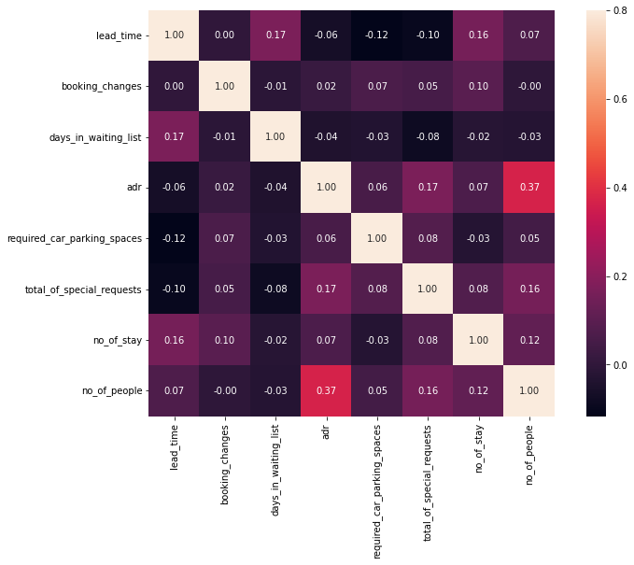
Correlation between the numerical data

Slide 8
Here adr(average daily rate) is correlated with no_of_people. It simply indicates that more revenue generated when number of people increases.
Then,lead time and number of stays are correlated it indicates that people take longer stay in hotels when booking is done more before then they arrive to stay.

Slide 9
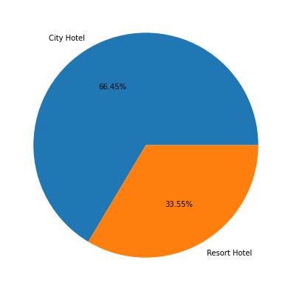
2.Preferred hotels types.
From the above pie chart, it seems like mostly people prefer city hotel type over resort hotel type. So, resort hotel type are more vacant than city hotel type.The percentage of city hotel is 66.45% while the percentage of resort hotel is 33.55%.

Slide 10
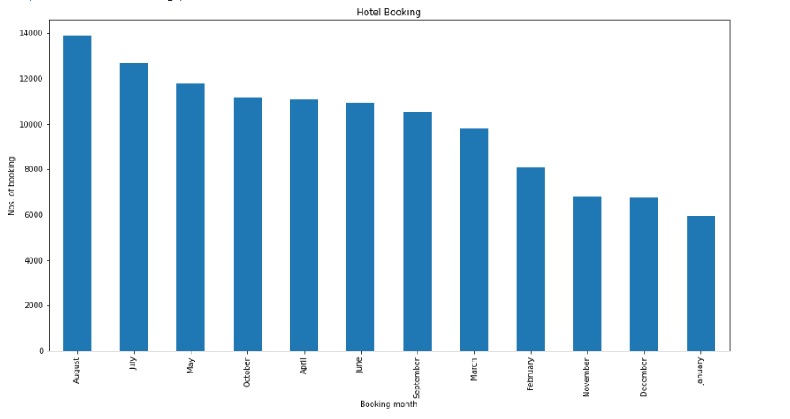
3.Which month has most peak booking?
August is the month or we can say that the time of the year in which hotel booking is at its peak. And january is the month in which hotel booking are least.

Slide 11
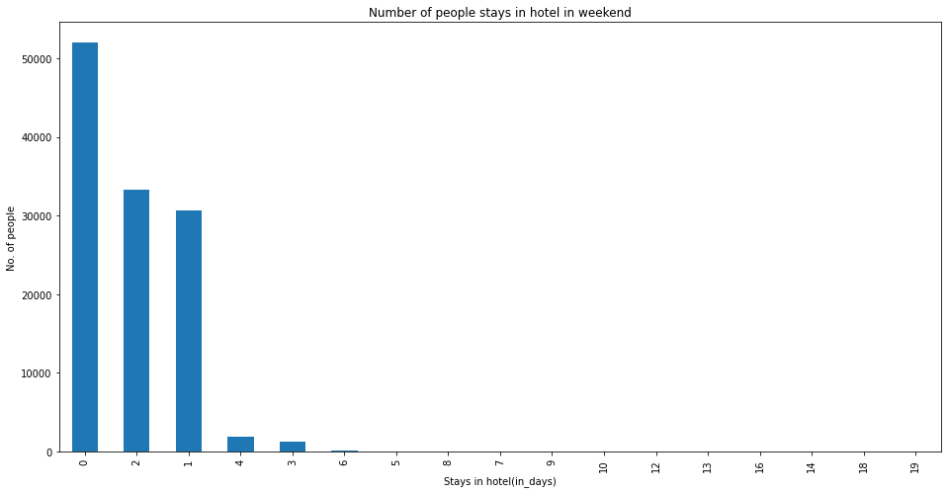
4(a).Optimal length of the stay in the hotel in weekends.
From above plotted graph we can say that more than 50,000 people use to stay less than 1 day in hotel and then 33,308 people use to stay 2 day and after that 30,626 people use to stay 1 day at night, when there is weekend.

Slide 12
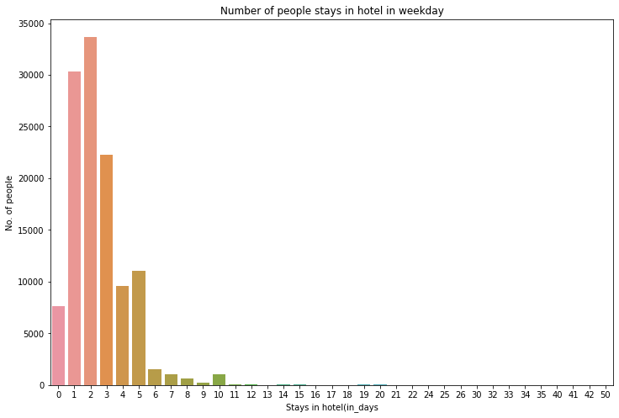
4(b).Optimal length of the stay in the hotel in weekdays.

Slide 13
Here from the output graph we can say that 2 day stay is preferred by 33,684 people and then 1 day stay is preferred. We can conclude from both weekend and weekday data and plotted graph that mostly people prefer weekend over weekdays to book or stay in hote ln for less than 1 day. If we consider weekdays then people go for 2 day stay.
So, according to the given data set the optimal length or favourable time of stay is less than 1 day for weekend and 2 day for weekday.

Slide 14
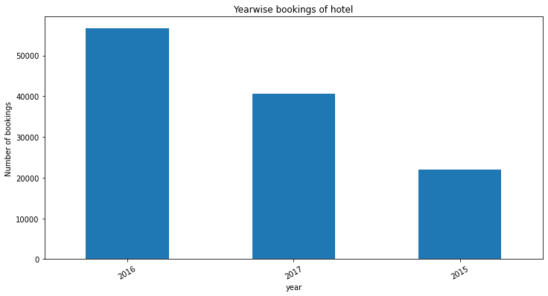
5.Which year has most peak bookings?
From the output graph year 2016 is highest booking year with total booking of 56,707 then booking decreased to 40,687. Also in the previous year of 2016 i.e 2015 less number of bookings occured. So, according to given data there is increment of bookings with alternate years.

Slide 15
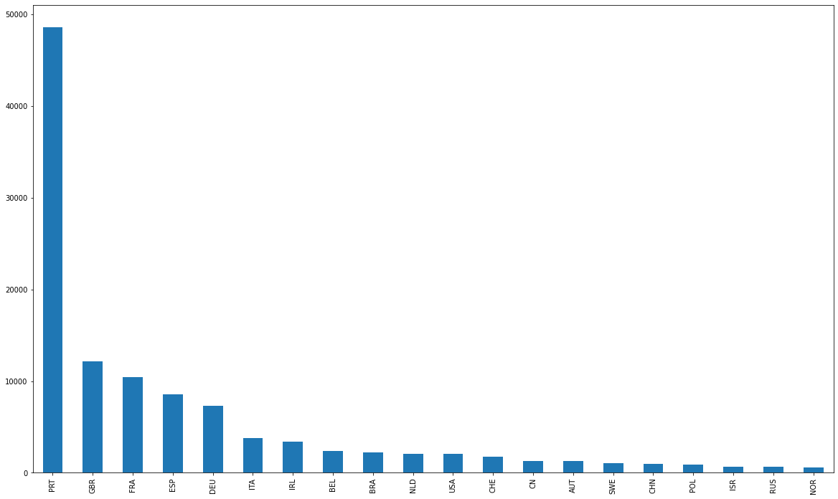
6.Which country has the most numbers booking done by the customer?

Slide 16
From the above graph, we can conclude from the graph that people of portugal(PRT) is doing maximum numbers of bookings or we can say portugal is best tourist attraction so that huge amount of tourist came and visit portugal and do hotel bookings to stay on weekend or weekdays.

Slide 17
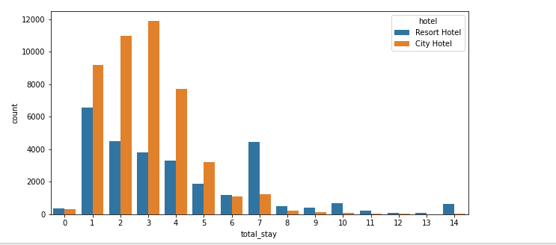
7. Preferred stay in each hotel on the basis of total number of bookings.

Slide 18
From this graph we can say that mostly people stay 1 to 4 days. Generally people go for City Hotels for staying short period of time but for longer period of stay people prefer Resort Hotel.

Slide 19
Conclusions from the above analysis-
Here adr(average daily rate) is correlated with no_of_people. It simply indicates that more revenue generated when number of people increases.
Then,lead time and number of stays are correlated it indicates that people take longer stay in hotels when booking is done more before then they arrive to stay.
The percentage of city hotel is 66.45% while the percentage of resort hotel is 33.55% is use to stay.
August is the month or we can say that the time of the year in which hotel booking is at its peak. And january is the month in which hotel booking are least.
According to the given data set the optimal length or favourable time of stay is less than 1 day for weekend and 2 day for weekday.
Year 2016 is highest booking year with total booking of 56,707 then booking decreased to 40,687.
Most of the guests came from european countries, with most no. of guest coming from Portugal.
Mostly people stay 1 to 4 days. Generally people go for City Hotels for staying short period of time but for longer period of stay people prefer Resort Hotel.

Slide 20
Thank you…

